Slide 1


The HORN Package Manager
Options for creating DSLs in .NET

Slide 2


Who Am I?

Slide 3

Why Horn?

Slide 4
Show me the Pain
Notes:
Finish demo here.

Slide 5

We Live On the bleeding Edge

Slide 6
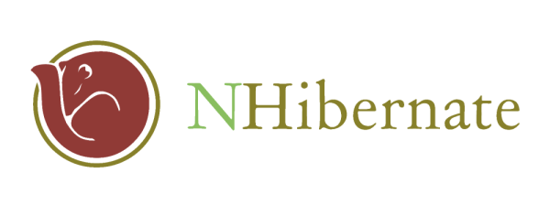


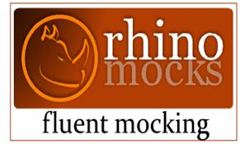

The Usual Suspects
ASP.NET MVCContrib

Slide 7

A Maze of Dependencies

Slide 8
Why source code and why NOT binary management?
The Usual Suspects
ASP.NET MVC Contrib

Slide 9
A typical Scenario
ASP.NET MVC Moves From Beta to Release Candidate
MVC Contrib needs rebuilt in against the latest mvc binaries
I use MVCContrib for Castle IOC Integration
MVCContrib uses the trunk version of Castle
I use Nhibernate
Nhibernate is built against a different castle version
I use Rhino
Rhino depends on Nhibernate and Castle
Etc., Etc., Etc., Etc.

Slide 10

Pain is Constant and Sharp

Slide 11
The Treadmill of Change is Always Turning
Notes:
Finish demo here.

Slide 12
Building the Stack (Surely Not)
C:\dev\Shared>cd NHibernate
C:\dev\Shared\Nhibernate>svn up
C:\dev\Shared\Nhibernate>cd nhibernate
C:\dev\Shared\NHibernate\nhibernate>nant
C:\dev\Shared\NHibernate>cd ..\..
C:\dev\Shared>cd Castle

Slide 13
Building the Stack (Surely Not)
C:\dev\Shared>cd NHibernate
C:\dev\Shared\Nhibernate>svn up
C:\dev\Shared\Nhibernate>cd nhibernate
C:\dev\Shared\NHibernate\nhibernate>nant
C:\dev\Shared\NHibernate>cd ..\..
C:\dev\Shared>cd Castle

Slide 14
Building the Stack (Surely Not)
C:\dev\Shared\Castle>svn up
C:\dev\Shared\Castle>nant
C:\dev\Shared\Castle>copy ..\NHibernate\nhibernate\build\NHibernate-
2.0.0.Alpha1-debug\bin\net-2.0\*.* build\net-2.0\debug /y
C:\dev\Shared\Castle>nant

Slide 15

And it goes on and on

Slide 16
Why has nobody else tackled this problem? Is it just us?
The Usual Suspects
ASP.NET MVC Contrib

Slide 17
We Need a Hero
The Usual Suspects
ASP.NET MVC Contrib

Slide 18

Gentoo Portage

Slide 19
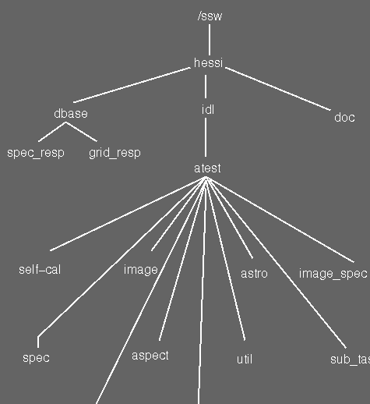
The Portage Tree Metaphor

Slide 20
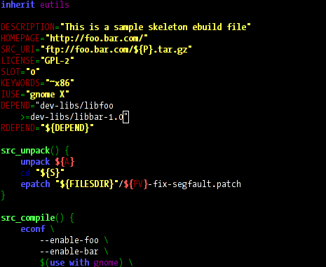
Ebuilds

Slide 21

(Horn DSL)== Ebuild

Slide 22
What about the &*$!ing DSL?
The Usual Suspects
ASP.NET MVC Contrib

Slide 23
Why not XML?
The Usual Suspects
ASP.NET MVC Contrib

Slide 24
XML is sooooo not cool anymore
The Usual Suspects
ASP.NET MVC Contrib

Slide 25
Why an Internal DSL?
The Usual Suspects
ASP.NET MVC Contrib

Slide 26
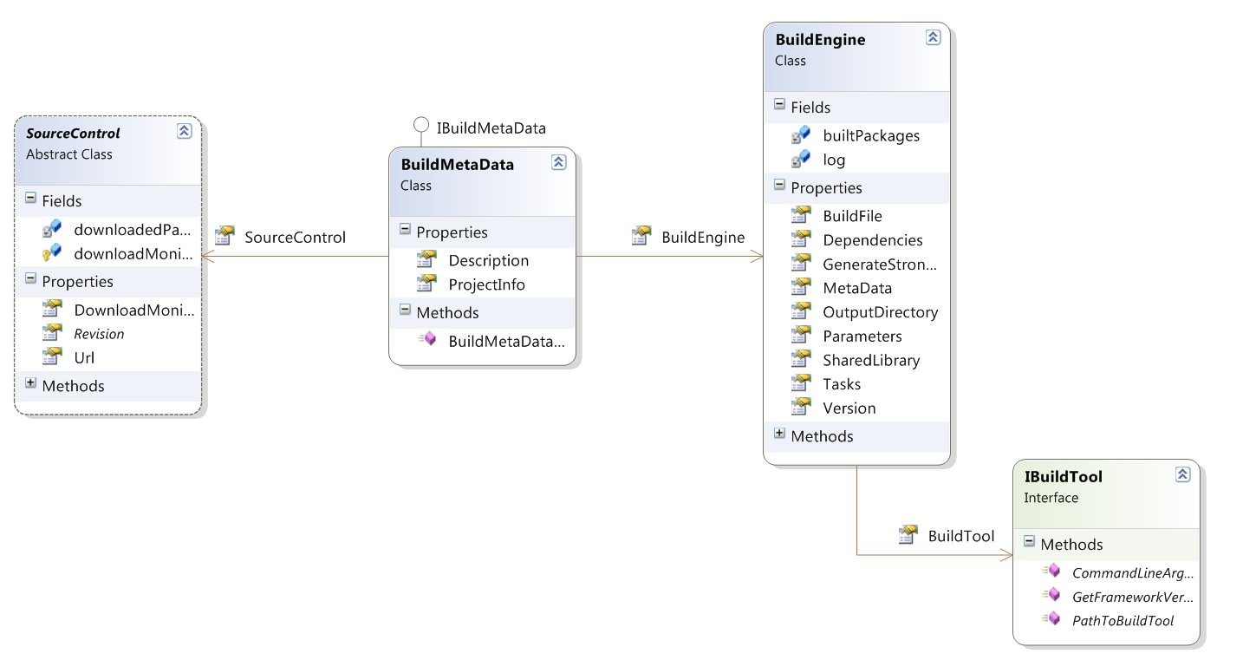
The Semantic Model

Slide 27
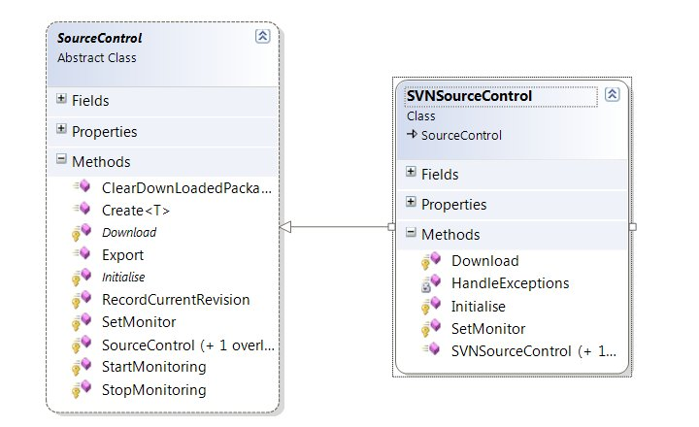
Source Control

Slide 28
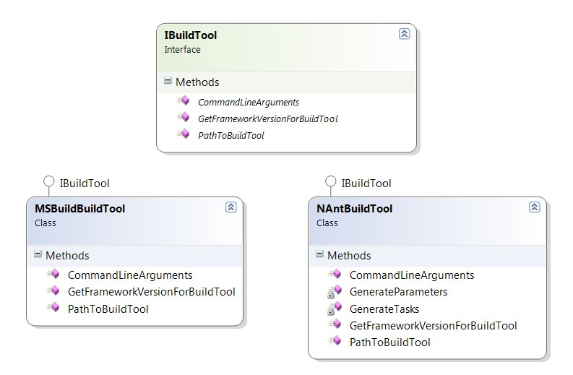
Build Engine

Slide 29

DSL Host language

Slide 30
Boo is.....
A lesser known CLI Language
An object oriented statically typed language
An Open source project, released under the BSD license.
A python inspired language
A language with a focus on compiler extensibility

Slide 31
Boo’s Dsl Qualities
Significant whitespace ala Python
Optional Parenthesis
Type inference and automatic type casting
Duck Typing
Compiler Extensibility

Slide 32
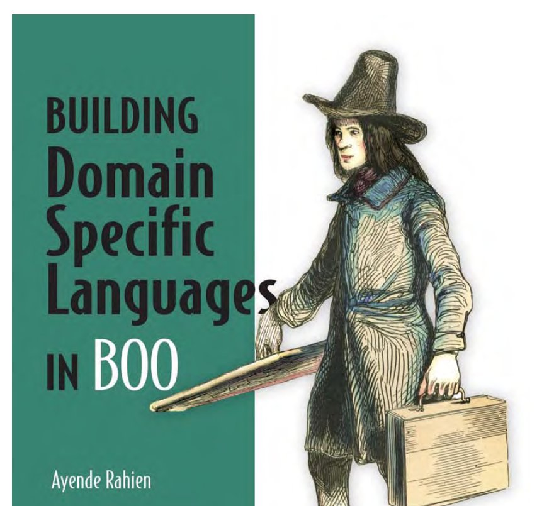
Duck Typing

Slide 33
Compiler Extension Points
Meta Methods
Duck Typing
AST Macros
AST Attributes

Slide 34

The Boo Compiler Pipeline

Slide 35
The anonymous base class step turns the Dsl Script into a class that is derived from the defined base class
The Usual Suspects
ASP.NET MVC Contrib

Slide 36
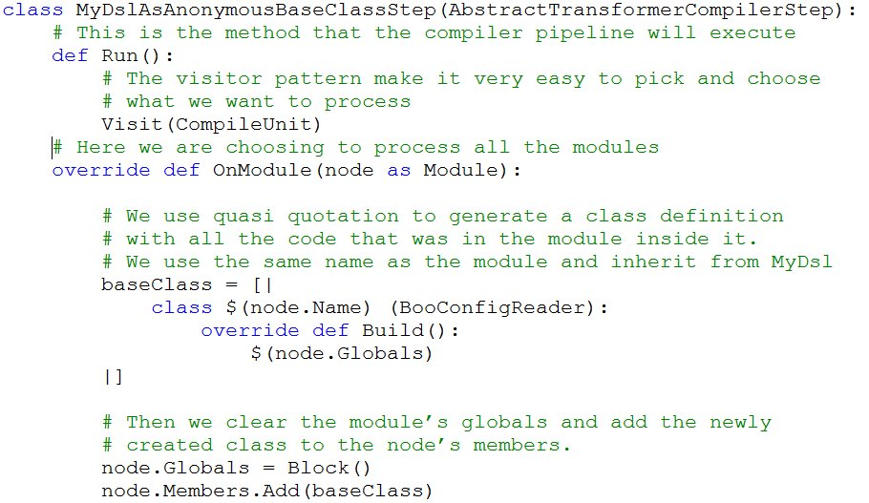

Slide 37
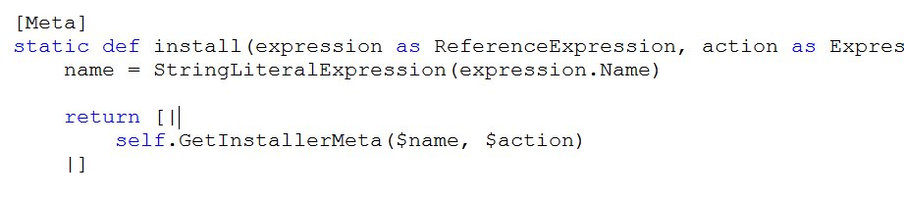
Meta Methods And Quasi Quotation

Slide 38
Meta Methods are invoked at compile time
The Usual Suspects
ASP.NET MVC Contrib

Slide 39
Meta Methods accept an AST node and Return an AST node
The Usual Suspects
ASP.NET MVC Contrib

Slide 40
Quasi Quotation is short hand code for generating an AST
The Usual Suspects
ASP.NET MVC Contrib

Slide 41
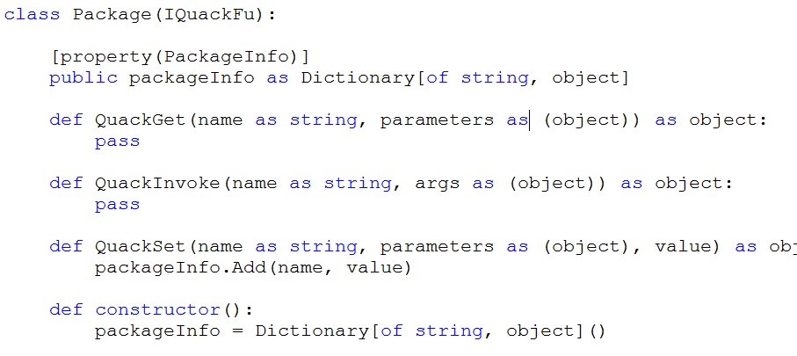
Duck Typing

Slide 42
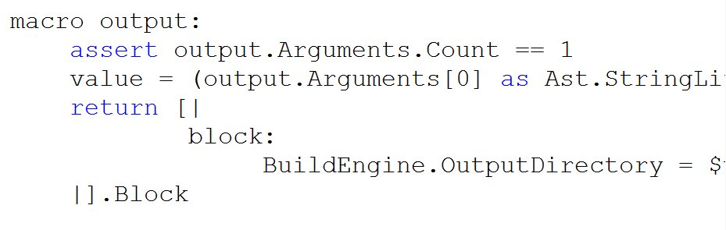
AST Macros

Slide 43
Macros have full access to the compiler context
The Usual Suspects
ASP.NET MVC Contrib

Slide 44

Some Aesthetic nice to haves

Slide 45
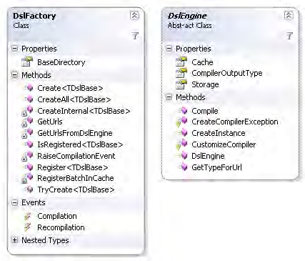
Rhino DSL

Slide 46
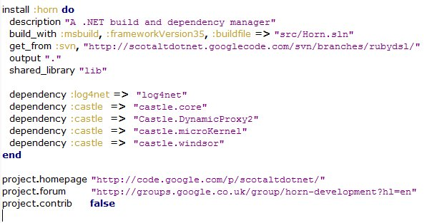
The IronRuby Horn DSL

Slide 47
IronRuby
.NET implementation of the Ruby language
Seamless Integration with .NET libraries
Compatibility with the 1.8.x branch

Slide 48
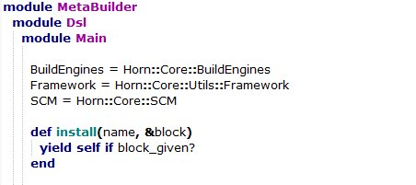
Mixins

Slide 49
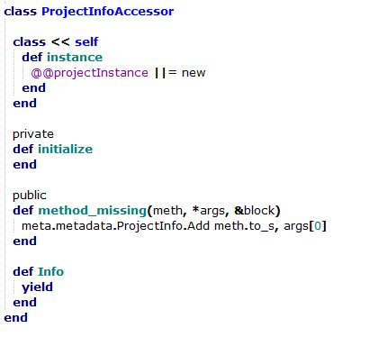
Method Missing

Slide 50
Current State of Horn
The Usual Suspects
ASP.NET MVC Contrib

Slide 51

Horn Needs You

Slide 52
dagda1@scotalt.net
The Usual Suspects
ASP.NET MVC Contrib

